Slide 1



$ℒ_{1}$-adaptive controller for a tractor-trailer trajectory following system
ME 562
William Drennan, Justin Yurkanin, and Sam Folorunsho
12/08/2021
Notes:
Hello everyone, my name is William, my groupmates are Sam and Justin, and we will be presenting our analysis of an L1 adaptive controller for a tractor-trailer system.

Slide 2






Tractor-Trailer System
Trailer
Tractor
$$\left(x_{i}, y_{i}\right)$$
Hitch
$$\left(x_{t}, y_{t}\right)$$
Trailer steering $δ_{i}$
Front wheel steering $δ$
Powered rear wheels $V$
ME562
GRAINGER ENGINEERING
Notes:
[William] To review, we are looking at a kinematic bike model of a tractor pulling a trailer, which has front wheel actuation. The model accounts for changes in surface properties and topology with a series of disturbance terms.

Slide 3
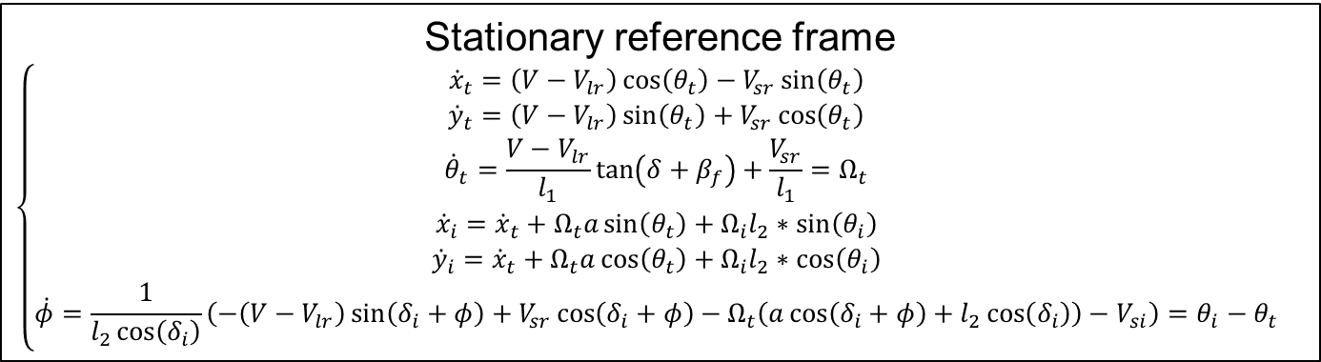

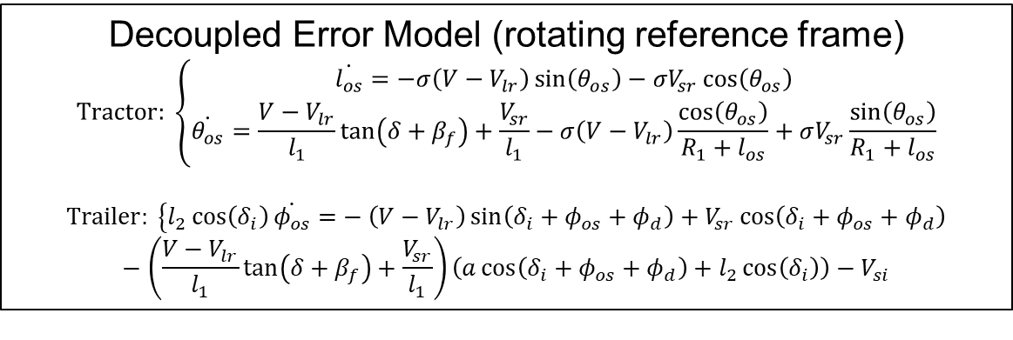
Offset model and reference path tracking
Stationary reference frame
$$\left\{\begin{matrix}{\dot{x}}_{t}=\left(V−V_{lr}\right)\cos\left(θ_{t}\right)−V_{sr}\sin\left(θ_{t}\right) \\ {\dot{y}}_{t}=\left(V−V_{lr}\right)\sin\left(θ_{t}\right)+V_{sr}\cos\left(θ_{t}\right) \\ {\dot{θ}}_{t}=\frac{V−V_{lr}}{l_{1}}\tan\left(δ+β_{f}\right)+\frac{V_{sr}}{l_{1}}=Ω_{t} \\ {\dot{x}}_{i}={\dot{x}}_{t}+Ω_{t}a\sin\left(θ_{t}\right)+Ω_{i}l_{2}∗\sin\left(θ_{i}\right) \\ {\dot{y}}_{i}={\dot{x}}_{t}+Ω_{t}a\cos\left(θ_{t}\right)+Ω_{i}l_{2}∗\cos\left(θ_{i}\right) \\ \dot{φ}=\frac{1}{l_{2}\cos\left(δ_{i}\right)}\left(−\left(V−V_{lr}\right)\sin\left(δ_{i}+φ\right)+V_{sr}\cos\left(δ_{i}+φ\right)−Ω_{t}\left(a\cos\left(δ_{i}+φ\right)+l_{2}\cos\left(δ_{i}\right)\right)−V_{si}\right)=θ_{i}−θ_{t}\end{matrix}\right.$$
assume $ζ=1$, $V>V_{lr}>0$
Require $R_{1}^{2}>l_{2}^{2}−a^{2}$
Decoupled Error Model (rotating reference frame)
$$Tractor: \left\{\begin{matrix}\dot{l_{os}}=−σ\left(V−V_{lr}\right)\sin\left(θ_{os}\right)−σV_{sr}\cos\left(θ_{os}\right) \\ \dot{θ_{os}}=\frac{V−V_{lr}}{l_{1}}\tan\left(δ+β_{f}\right)+\frac{V_{sr}}{l_{1}}−σ\left(V−V_{lr}\right)\frac{\cos\left(θ_{os}\right)}{R_{1}+l_{os}}+σV_{sr}\frac{\sin\left(θ_{os}\right)}{R_{1}+l_{os}}\end{matrix}\right.$$
$$Trailer: \left\{l_{2}\cos\left(δ_{i}\right)\dot{φ_{os}}=\right.−\left(V−V_{lr}\right)\sin\left(δ_{i}+φ_{os}+φ_{d}\right)+V_{sr}\cos\left(δ_{i}+φ_{os}+φ_{d}\right)−\left(\frac{V−V_{lr}}{l_{1}}\tan\left(δ+β_{f}\right)+\frac{V_{sr}}{l_{1}}\right)\left(a\cos\left(δ_{i}+φ_{os}+φ_{d}\right)+l_{2}\cos\left(δ_{i}\right)\right)−V_{si}$$
ME562
GRAINGER ENGINEERING
Notes:
[William] In our previous presentation we went over the coordinate changes necessary to put the system into a reduced order, rotating reference frame.

Slide 4
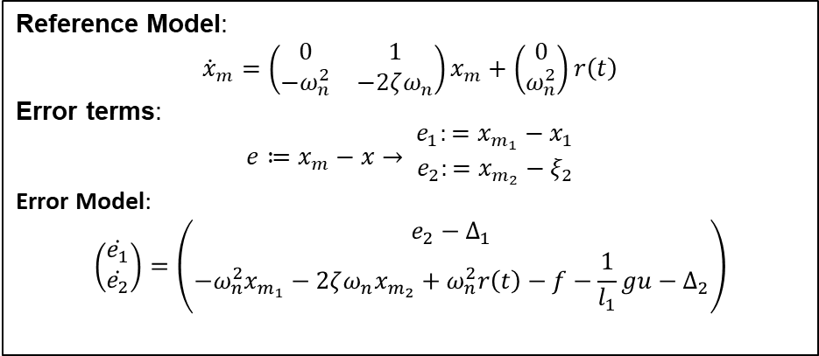
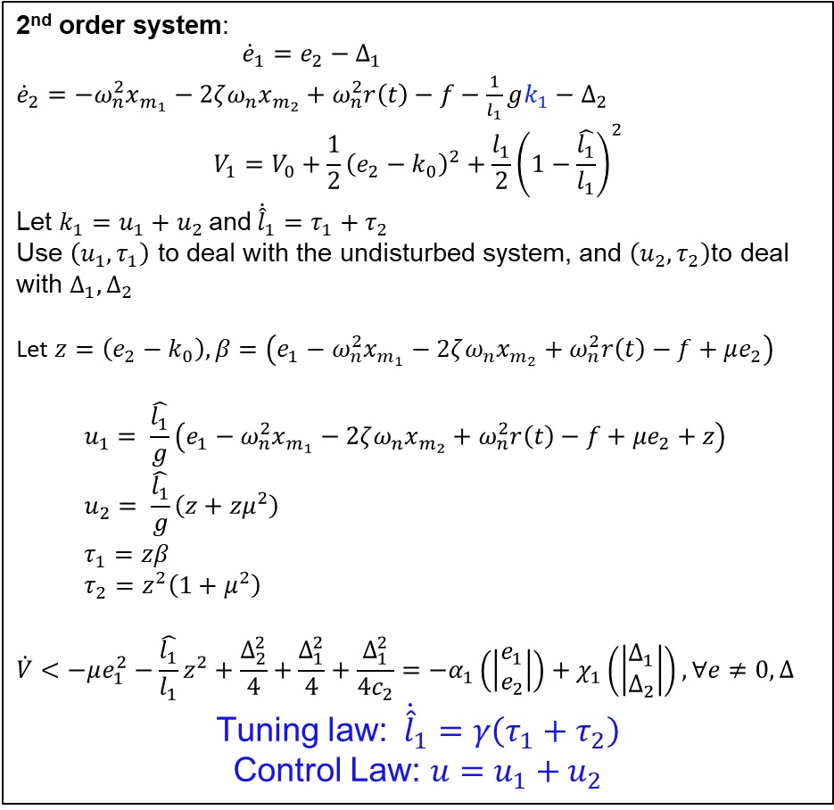
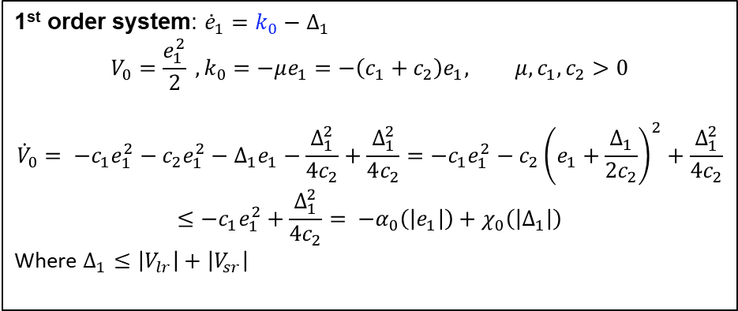
Indirect MRAC for the tractor with adaptive ISS backstepping
2nd order system: $\begin{matrix}{\dot{e}}_{1}=e_{2}−Δ_{1} \\ {\dot{e}}_{2}=−ω_{n}^{2}x_{m_{1}}−2ζω_{n}x_{m_{2}}+ω_{n}^{2}r\left(t\right)−f−\frac{1}{l_{1}}gk_{1}−Δ_{2}\end{matrix}$
$$V_{1}=V_{0}+\frac{1}{2}{\left(e_{2}−k_{0}\right)}^{2}+\frac{l_{1}}{2}{\left(1−\frac{\hat{l_{1}}}{l_{1}}\right)}^{2}$$
Let $k_{1}=u_{1}+u_{2}$and${\dot{\hat{l}}}_{1}=τ_{1}+τ_{2}$
Use $\left(u_{1},τ_{1}\right)$ to deal with the undisturbed system, and $\left(u_{2},τ_{2}\right)$to deal with $Δ_{1},Δ_{2}$
Let $z=\left(e_{2}−k_{0}\right), β=\left(e_{1}−ω_{n}^{2}x_{m_{1}}−2ζω_{n}x_{m_{2}}+ω_{n}^{2}r\left(t\right)−f+μe_{2}\right)$
$$u_{1}= \frac{\hat{l_{1}}}{g}\left(e_{1}−ω_{n}^{2}x_{m_{1}}−2ζω_{n}x_{m_{2}}+ω_{n}^{2}r\left(t\right)−f+μe_{2}+z\right)$$
$$u_{2}= \frac{\hat{l_{1}}}{g}\left(z+zμ^{2}\right)$$
$$τ_{1}=zβ$$
$$τ_{2}=z^{2}\left(1+μ^{2}\right)$$
$$\dot{V}<−μe_{1}^{2}−\frac{\hat{l_{1}}}{l_{1}}z^{2}+\frac{Δ_{2}^{2}}{4}+\frac{Δ_{1}^{2}}{4}+\frac{Δ_{1}^{2}}{4c_{2}}=−α_{1}\left(\left|\begin{matrix}e_{1} \\ e_{2}\end{matrix}\right|\right)+χ_{1}\left(\left|\begin{matrix}Δ_{1} \\ Δ_{2}\end{matrix}\right|\right), ∀e≠0, Δ$$
Tuning law: ${\dot{\hat{l}}}_{1}=γ\left(τ_{1}+τ_{2}\right)$
Control Law: $u=u_{1}+u_{2}$
Reference Model:
$${\dot{x}}_{m}=\left(\begin{matrix}0 & 1 \\ −ω_{n}^{2} & −2ζω_{n}\end{matrix}\right)x_{m}+\left(\begin{aligned}0 \\ ω_{n}^{2}\end{aligned}\right)r\left(t\right)$$
Error terms:
$$e≔x_{m}−x→ \begin{matrix}e_{1}:=x_{m_{1}}−x_{1} \\ e_{2}:=x_{m_{2}}−ξ_{2}\end{matrix}$$
Error Model:
$$\left(\begin{aligned}\dot{e_{1}} \\ \dot{e_{2}}\end{aligned}\right)=\left(\begin{aligned}e_{2}−Δ_{1} \\ −ω_{n}^{2}x_{m_{1}}−2ζω_{n}x_{m_{2}}+ω_{n}^{2}r\left(t\right)−f−\frac{1}{l_{1}}gu−Δ_{2}\end{aligned}\right)$$
1st order system: ${\dot{e}}_{1}=k_{0}−Δ_{1}$
$$V_{0}=\frac{e_{1}^{2}}{2} , k_{0}=−μe_{1}=−\left(c_{1}+c_{2}\right)e_{1}, μ,c_{1},c_{2}>0$$
$${\dot{V}}_{0}= −c_{1}e_{1}^{2}−c_{2}e_{1}^{2}−Δ_{1}e_{1}−\frac{Δ_{1}^{2}}{4c_{2}}+\frac{Δ_{1}^{2}}{4c_{2}}=−c_{1}e_{1}^{2}−c_{2}{\left(e_{1}+\frac{Δ_{1}}{2c_{2}}\right)}^{2}+\frac{Δ_{1}^{2}}{4c_{2}}$$
$$≤−c_{1}e_{1}^{2}+\frac{Δ_{1}^{2}}{4c_{2}}= −α_{0}\left(\left|e_{1}\right|\right)+χ_{0}\left(\left|Δ_{1}\right|\right)$$
Where $Δ_{1}≤\left|V_{lr}\right|+\left|V_{sr}\right|$
ME562
GRAINGER ENGINEERING
Notes:
[William] Then in this rotating reference frame, we accounted for the disturbance terms by we performed ISS-backstepping, putting a bound on the influence of the disturbances. This Indirect MRAC controller will be compared to an L1 adaptive controller in this presentation.

Slide 5
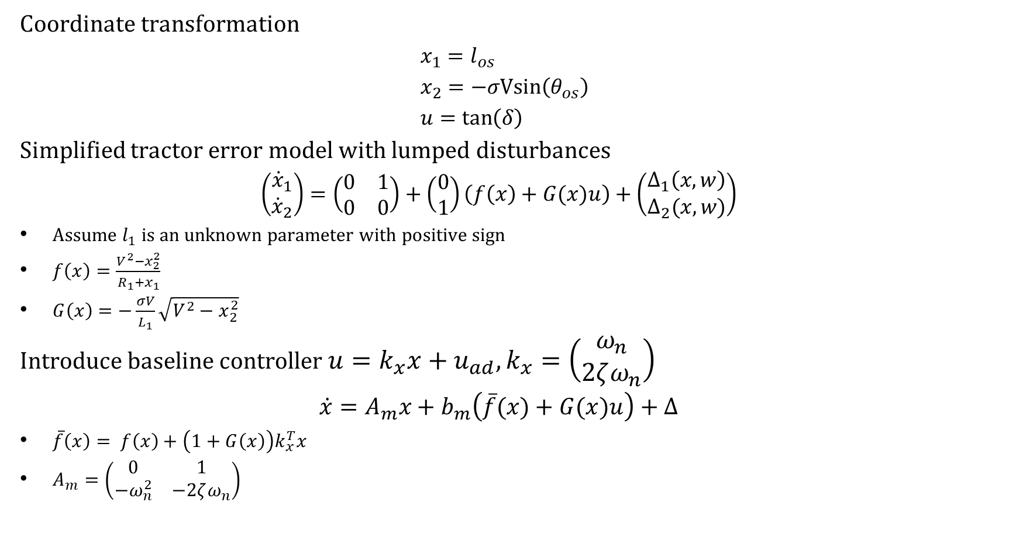
Baseline controller for L1 adaptive controller
Coordinate transformation
$$x_{1}=l_{os}$$
$$x_{2}=−σVsin\left(θ_{os}\right)$$
$$u=\tan\left(δ\right)$$
Simplified tractor error model with lumped disturbances
$$\left(\begin{matrix}{\dot{x}}_{1} \\ {\dot{x}}_{2}\end{matrix}\right)=\left(\begin{matrix}0 & 1 \\ 0 & 0\end{matrix}\right)+\left(\begin{aligned}0 \\ 1\end{aligned}\right)\left(f\left(x\right)+G(x)u\right)+\left(\begin{matrix}Δ_{1}\left(x,w\right) \\ Δ_{2}(x,w)\end{matrix}\right)$$
Assume $l_{1}$ is an unknown parameter with positive sign
$f\left(x\right)=\frac{V^{2}−x_{2}^{2}}{R_{1}+x_{1}}$
$G\left(x\right)=−\frac{σV}{L_{1}}\sqrt{V^{2}−x_{2}^{2}}$
Introduce baseline controller $u=k_{x}x+u_{ad}, k_{x}=\left(\begin{aligned}ω_{n} \\ 2ζω_{n}\end{aligned}\right)$
$$\dot{x}=A_{m}x+b_{m}\left(\overline{f}(x)+G(x)u\right)+Δ$$
$\overline{f}\left(x\right)= f\left(x\right)+\left(1+G\left(x\right)\right)k_{x}^{T}x$
$A_{m}=\left(\begin{matrix}0 & 1 \\ −ω_{n}^{2} & −2ζω_{n}\end{matrix}\right)$
(1)
(2)
ME562
GRAINGER ENGINEERING
Notes:
[William] To create the L1 baseline controller, be divided the control law into two terms, and selected our stable reference model dynamics Am to be a damped 2nd order system. Equation (1) is the original system. Equation (2) is the system after introducing the baseline controller. The nonlinear functions f-bar-(x) and G(x) are well behaved and continuous around the equilibrium, and up to the point when the tractor is perpendicular to the curvilinear path. (It may have been possible to control the original, stationary reference frame system without having to worry about this problem.)

Slide 6
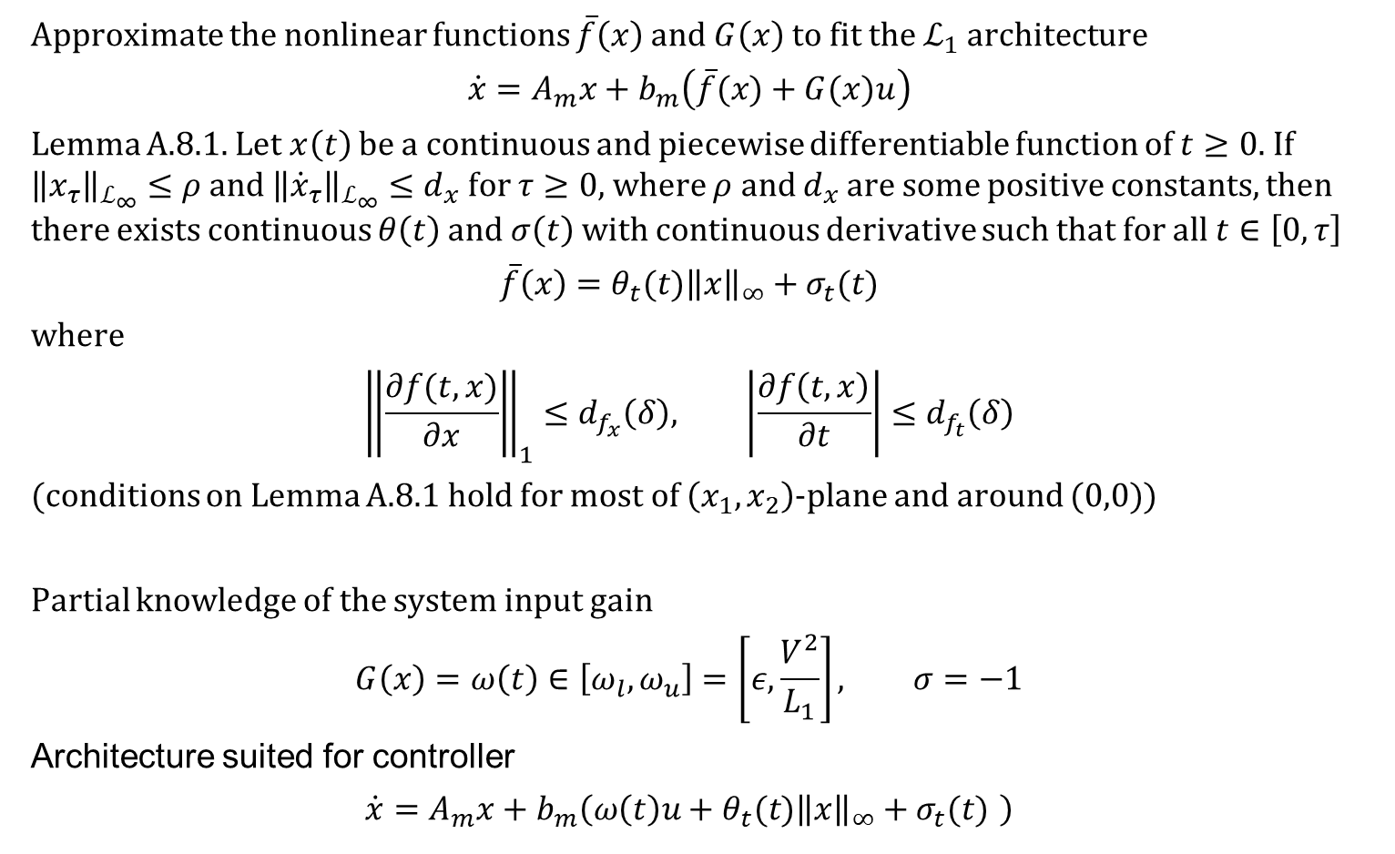
Linear Parametrization of Nonlinear systems and Linear Time-Varying representations of systems with unmodelled Actuator Dynamics
Approximate the nonlinear functions $\overline{f}\left(x\right)$ and $G\left(x\right)$ to fit the $ℒ_{1}$ architecture
$$\dot{x}=A_{m}x+b_{m}\left(\overline{f}(x)+G(x)u\right)$$
Lemma A.8.1. Let $x\left(t\right)$ be a continuous and piecewise differentiable function of $t≥0$. If ${\left\|x_{τ}\right\|}_{ℒ_{∞}}≤ρ$ and ${\left\|{\dot{x}}_{τ}\right\|}_{ℒ_{∞}}≤d_{x}$ for $τ≥0$, where $ρ$ and $d_{x}$ are some positive constants, then there exists continuous $θ\left(t\right)$ and $σ\left(t\right)$ with continuous derivative such that for all $t∈\left[0,τ\right]$
$$\overline{f}\left(x\right)=θ_{t}(t){\left\|x\right\|}_{∞}+σ_{t}(t)$$
where
$${\left\|\frac{∂f(t,x)}{∂x}\right\|}_{1}≤d_{f_{x}}\left(δ\right), \left|\frac{∂f\left(t,x\right)}{∂t}\right|≤d_{f_{t}}\left(δ\right)$$
(conditions on Lemma A.8.1 hold for most of $\left(x_{1},x_{2}\right)$-plane and around $(0,0)$)
Partial knowledge of the system input gain
$$G\left(x\right)=ω\left(t\right)∈\left[ω_{l}, ω_{u}\right]=\left[ε,\frac{V^{2}}{L_{1}}\right], σ=−1$$
Architecture suited for controller
$$\dot{x}=A_{m}x+b_{m}\left(ω\left(t\right)u+θ_{t}(t){\left\|x\right\|}_{∞}+σ_{t}(t) \right)$$
(3)
(4)
(5)
ME562
GRAINGER ENGINEERING
Notes:
[William] In order to arrive at equation (5) which is a helpful form for implementing the L-1-adaptive controller, we require ways to replace the functions F-bar and G. We can use a lemma from the appendix of the L1 adaptive control textbook to replace fbar with the equation in (3). Further, we can use partial knowledge of the system input gain to consider a time-varying system input gain on some domain Omega. For the sake of deriving the control law, we ignored the model’s disturbances, although it may be possible to incorporate them into fbar.

Slide 7
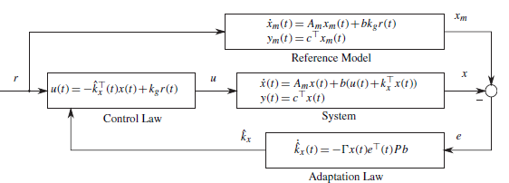
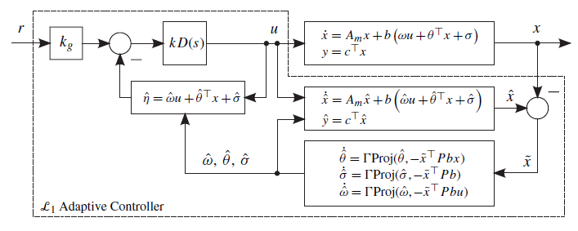


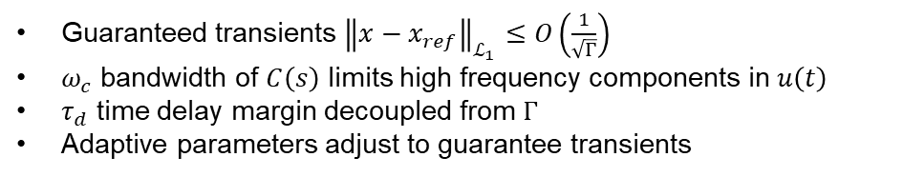

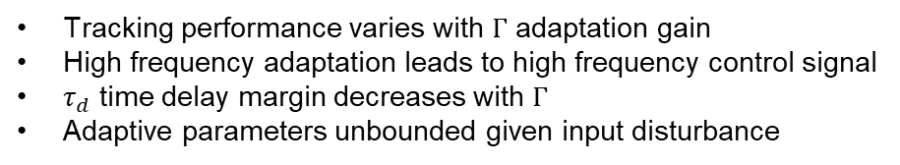


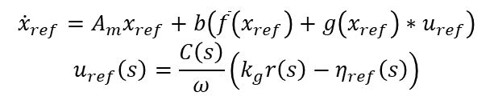
L1 adaptive controller architecture
MRAC
$ℒ_{1}$-adaptive control
$$x_{m}\left(t\right)$$
$$x\left(t\right)$$
$$x_{ref}\left(t\right)$$
$${\dot{x}}_{m}=\left(\begin{matrix}0 & 1 \\ −ω_{n}^{2} & −2ζω_{n}\end{matrix}\right)x_{m}+\left(\begin{aligned}0 \\ ω_{n}^{2}\end{aligned}\right)r\left(t\right)$$
$${\dot{x}}_{ref}=A_{m}x_{ref}+b\left(\overline{f}\left(x_{ref}\right)+g\left(x_{ref}\right)∗u_{ref}\right)$$
$$u_{ref}\left(s\right)=\frac{C\left(s\right)}{ω}\left(k_{g}r\left(s\right)−η_{ref}\left(s\right)\right)$$
Tracking performance varies with $Γ$ adaptation gain
High frequency adaptation leads to high frequency control signal
$τ_{d}$ time delay margin decreases with $Γ$
Adaptive parameters unbounded given input disturbance
Guaranteed transients ${\left\|x−x_{ref}\right\|}_{ℒ_{1}}≤O\left(\frac{1}{\sqrt{Γ}}\right)$
$ω_{c}$ bandwidth of $C\left(s\right)$ limits high frequency components in $u\left(t\right)$
$τ_{d}$ time delay margin decoupled from $Γ$
Adaptive parameters adjust to guarantee transients
Figures 1.1 and 2.13 from Hovakimyan, N., & Cao, C. (2010). L1 adaptive control theory : guaranteed robustness with fast adaptation . Society for Industrial and Applied Mathematics SIAM, 3600 Market Street, Floor 6, Philadelphia, PA 19104.
GRAINGER ENGINEERING
Notes:
[William] Now that we have our tractor system in a standard form, we can design the L1 adaptive control law in the same way as we have been seeing in the other presentations.
Because of how the L1 adaptive control puts bounds on the system during transients based on a reference system, we expect to see differences in the transient performance of the two controllers.
In the following slides, we will look at the effect of changing the LPF and the bandwidth on the L1-norm condition and the robustness of the system.

Slide 8
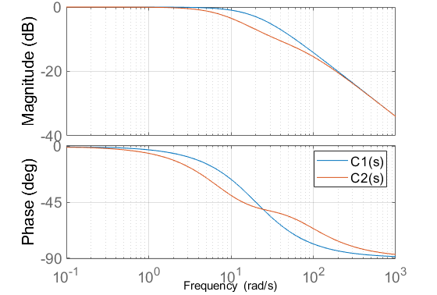
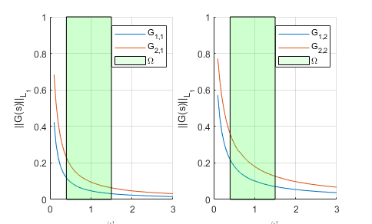

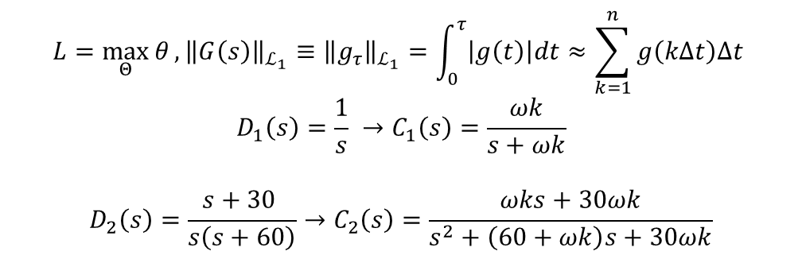


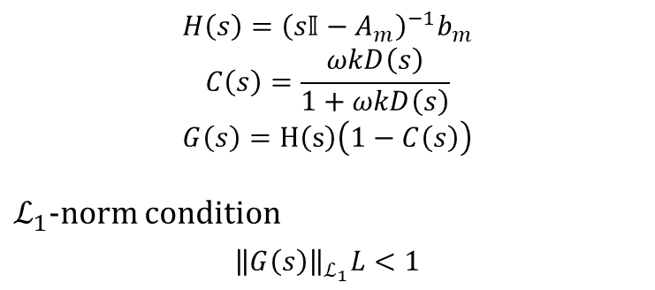

L1-norm condition and filter design $C(s)=\frac{ωkD\left(s\right)}{1+ωkD\left(s\right)}$, $k=20$
$$H\left(s\right)={\left(s𝕀−A_{m}\right)}^{−1}b_{m}$$
$$C\left(s\right)=\frac{ωkD\left(s\right)}{1+ωkD\left(s\right)}$$
$$G\left(s\right)=H\left(s\right)\left(1−C\left(s\right)\right)$$
$ℒ_{1}$-norm condition
$${\left\|G\left(s\right)\right\|}_{ℒ_{1}}L<1$$
$$L=\max_{Θ}{θ}, {\left\|G\left(s\right)\right\|}_{ℒ_{1}}≡{\left\|g_{τ}\right\|}_{ℒ_{1}}=\int_{0}^{τ}{\left|g\left(t\right)\right|dt}≈\sum_{k=1}^{n}{g\left(kΔt\right)Δt }$$
$$D_{1}\left(s\right)=\frac{1}{s} →C_{1}\left(s\right)=\frac{ωk}{s+ωk}$$
$$D_{2}\left(s\right)=\frac{s+30 }{s\left(s+60\right)}→C_{2}\left(s\right)=\frac{ωks+30ωk}{s^{2}+\left(60+ωk\right)s+30ωk}$$
$${\left\|G\left(s\right)\right\|}_{ℒ_{1}}$$
$${\left\|G\left(s\right)\right\|}_{ℒ_{1}}$$
$$ω$$
$$ω$$
ME562
GRAINGER ENGINEERING
Notes:
[William] First, we will look at the filters we will be using. We are looking for filters which guarantee that the product of the L1norm of the transfer function G(s) is less than 1 over the maximum value of the parameter theta. In our system, theta max is approximately 1, so we are just looking to see the the L1-norm of G(s) is less than 1 for the range of values of the input gain that we might see. The domain of the input gain omega is highlighted in green in the figures on the right. For filters C1 and C2 given above the plot, the l1-norm is sufficiently small for the same bandwidth parameter k = 20.

Slide 9
Example search for time delay margin for $C_{1}\left(s\right), k=50, Γ=1000$
Time delay margin based on when oscillations in $\left(l_{os}, θ_{os}\right)$ start to grow
ME562
GRAINGER ENGINEERING
Notes:
[Justin] The first thing we did was look at how the time delay margin differs between the MRAC controller and the L1-adaptive controllers with our two filter designs. The approach for finding the time delay margin was to use an ODE solver intended for stiff equations and to look for the approximate time delay which caused the system to go unstable. Here is an example where around 250 ms, the L1-adaptive controller using the first filter C-sub-one-(s) causes the system is go unstable.

Slide 10
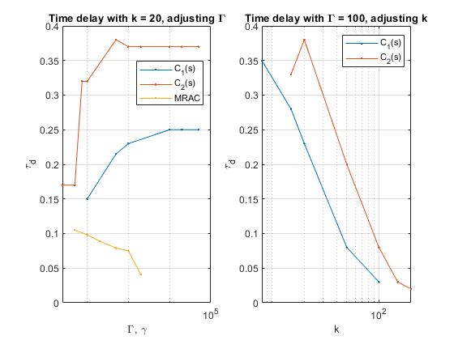





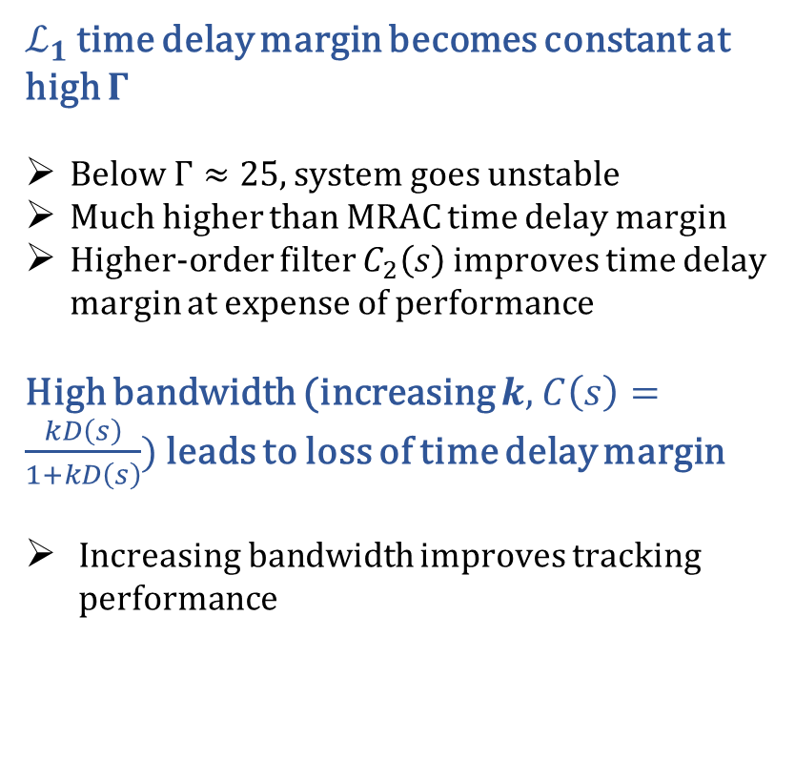
Time delay margin for varying $k,$ $C_{i}\left(s\right)$, $Γ$ for MRAC and $ℒ_{1}$-adaptive control
$ℒ_{1}$ time delay margin becomes constant at high $Γ$
Below $Γ≈25,$ system goes unstable
Much higher than MRAC time delay margin
Higher-order filter $C_{2}\left(s\right)$ improves time delay margin at expense of performance
High bandwidth (increasing $k,$ $C\left(s\right)=\frac{kD\left(s\right)}{1+kD\left(s\right)}$) leads to loss of time delay margin
Increasing bandwidth improves tracking performance
$${10}^{2}$$
$${10}^{3}$$
$${10}^{4}$$
$${10}^{5}$$
$k∝ω_{c}$Bandwidth
ME562
GRAINGER ENGINEERING
Notes:
[Justin] Here we have the aggregated results of searching for the time delay margin for various adaptive gains and filter bandwidth. The first figure on the left shows the time delay margin for changing gamma. In all causes, the time delay margin for the L1-adaptive controller was higher than for the MRAC controller. Additionally, we see the expected behavior for the L1-adaptive-controllers where there is an initial dip in the time delay margin followed by an increase to some steady state value at high gain. We do not see the behavior at low gain, because in these situations, the system went unstable. We see that using the high order filter C-sub-2 improved the time delay margin.
In the figure on the right, we see that increasing the bandwidth of the filters causes their time delay margins to vanish. This represents trading performance for robustness.

Slide 11
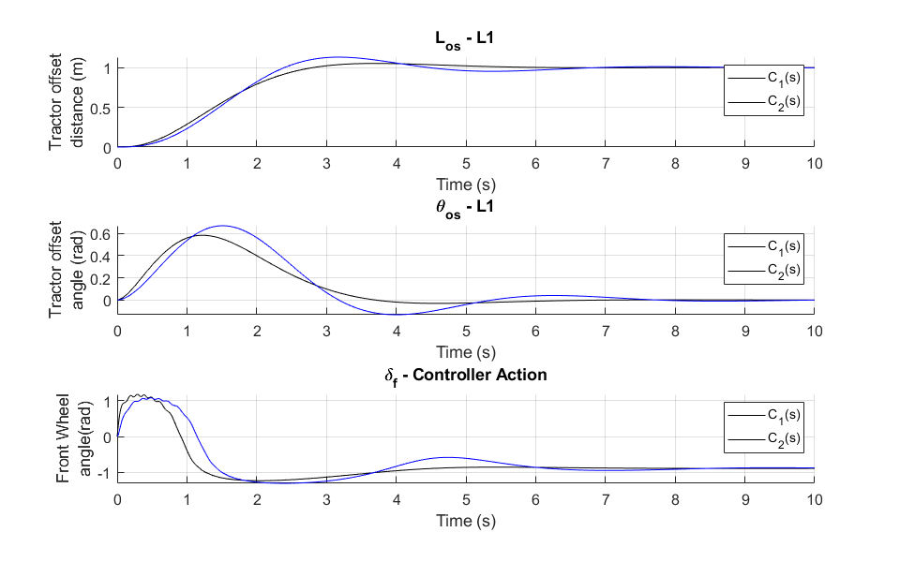
Example comparing performance between $C_{1}\left(s\right)$ and $C_{2}\left(s\right)$, $k=20$, $Γ=1000$
Example of slower transient for $C_{2}\left(s\right)$ for same $k$, $Γ$
Higher order filter trades some performance for robustness ($C_{2}\left(s\right)$ has higher $τ_{d}$)
ME562
GRAINGER ENGINEERING
Notes:
[Justin] First, we have here an example comparing the two filters for the same parameters and gain. We see that the lower-order filter C-sub-1 has a faster transient than the high order filter C-sub-2. This is again an example of trading performance for robustness as the time delay margin of C-sub-2 is greater.

Slide 12
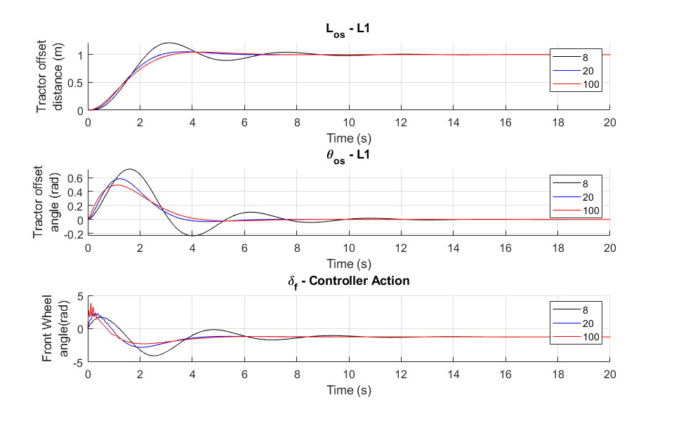
Increasing bandwidth $k$ of filter improves tracking (transient speed)
At higher bandwidth, high frequency components noticeable in control signal
Below $k≈8$, system is unstable as $ℒ_{1}$-norm condition fails
ME562
GRAINGER ENGINEERING
Notes:
[Justin] Here we show an example of what increasing the filter bandwidth “k” is doing to the tracking performance. We see in the first figure how changing k from its smallest stable value of 8 to 100 increases the transient speed. We also see in the third graph how higher order components enter into the control signal for high bandwidth. This is again showing that trade-off between performance and robustness.

Slide 13
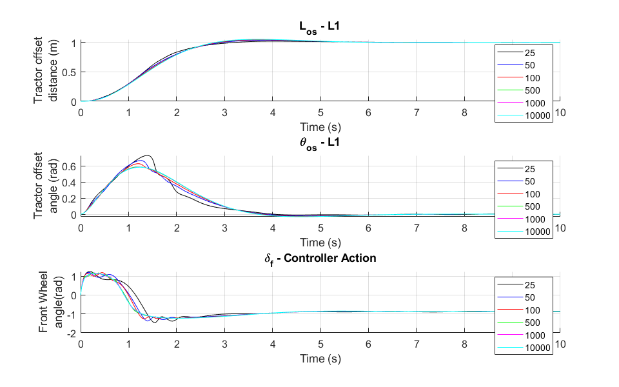
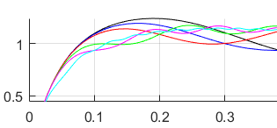
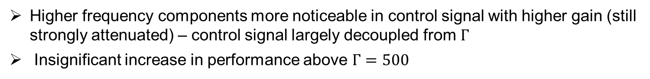
Increasing $Γ$ adaptive gain improves tracking for $ℒ_{1}$
CHART / GRAPH
call out
call out
Higher frequency components more noticeable in control signal with higher gain (still strongly attenuated) – control signal largely decoupled from $Γ$
Insignificant increase in performance above $Γ=500$
ME562
GRAINGER ENGINEERING
Notes:
[Justin] Here we look at what increasing the adaptive gain does for performance and controller action in L1. From the second plot, we can see that increasing the gain improves the performance towards some reference system, up to a point. Beyond gamma = 500, there is minimal improvement in the tracking, but there are changes in the control signal, where higher gamma does introduce small, high frequency fluctuations in the control signal. Although L1 decouples gamma and the control signal, it only does it up to a point. If you crank up gamma large enough, you will still expect to see attenuated high frequency components in the control signal. This behavior is a little hard to observe because the higher you make gamma, the stiffer the adaptive laws become, and so gamma is going to be limited by your solver and your CPU.

Slide 14
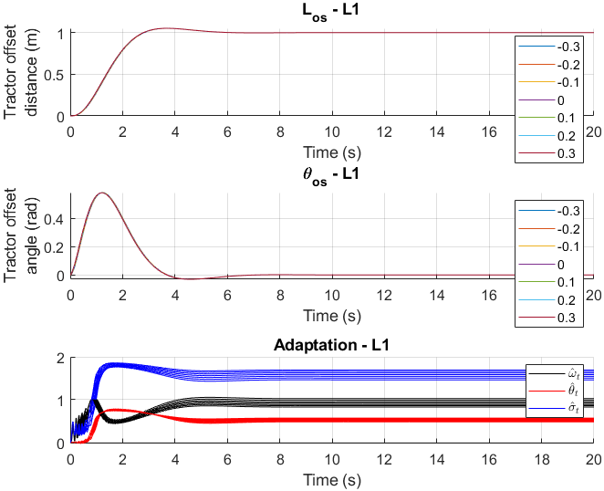
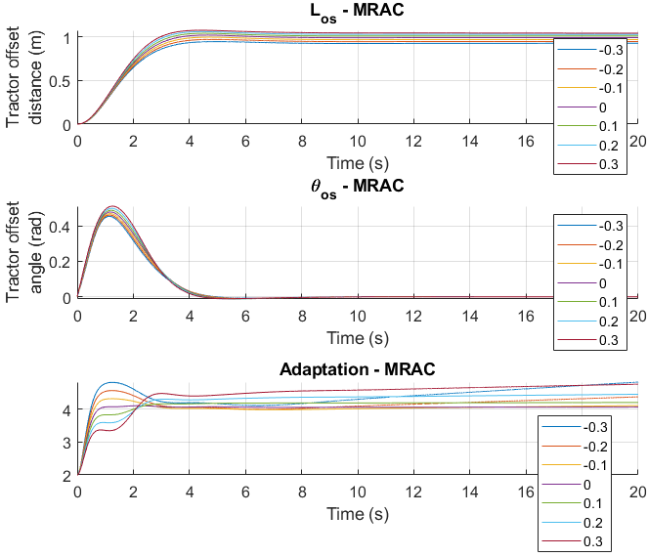
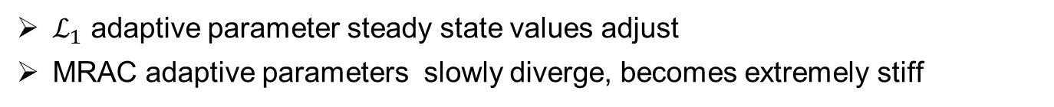
System subject to constant input disturbance $u\left(t\right)=u_{ad}\left(t\right)+k_{x}^{T}x+C, δ=\tan^{−1}\left(u\left(t\right)\right)$
$ℒ_{1}$ adaptive parameter steady state values adjust
MRAC adaptive parameters slowly diverge, becomes extremely stiff
ME562
GRAINGER ENGINEERING
Notes:
[Justin] We will now move on and look at the effects of input disturbances, which bypass the filter C(s) and go straight into the system. Looking here first at constant input disturbances, we see that the L1 adaptive controller has similar performance for small constant disturbances, with the adapting parameters adjusting to compensate. On the right, we see for MRAC that the unknown parameter estimate diverges for constant input disturbance. We would like to draw attention to the fact that the MRAC system accepts much larger input disturbances thanks to the ISS-derivation of the controller which is designed to deal with some input disturbances. The system with the L1 controller would go unstable for comparable disturbances.

Slide 15
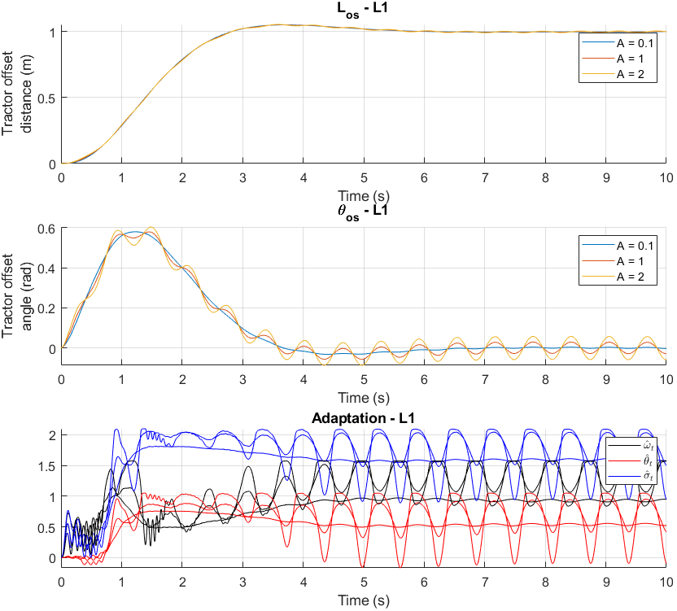
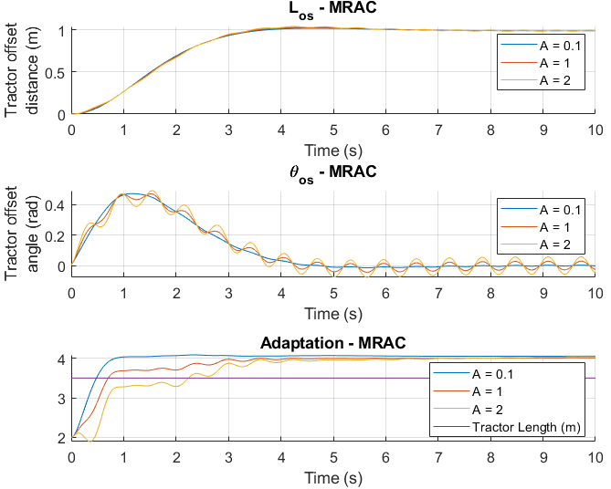
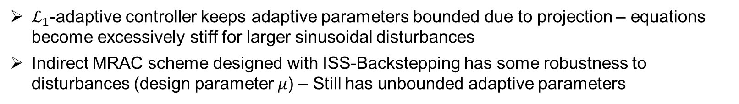
Comparing transient performance between MRAC and $ℒ_{1}$-adaptive control for sinusoidal disturbance without retuning of $Γ$, $u\left(t\right)=u_{ad}\left(t\right)+k_{x}^{T}x+Asin\left(10t\right)$
$ℒ_{1}$-adaptive controller keeps adaptive parameters bounded due to projection – equations become excessively stiff for larger sinusoidal disturbances
Indirect MRAC scheme designed with ISS-Backstepping has some robustness to disturbances (design parameter $μ$) – Still has unbounded adaptive parameters
ME562
GRAINGER ENGINEERING
Notes:
[Justin] Here we have the response for sinusoidal disturbances. The performance is comparable, and the adaptative parameters oscillate for L1. The MARC parameter estimate is slowly diverging, and misses the actual tractor length.

Slide 16
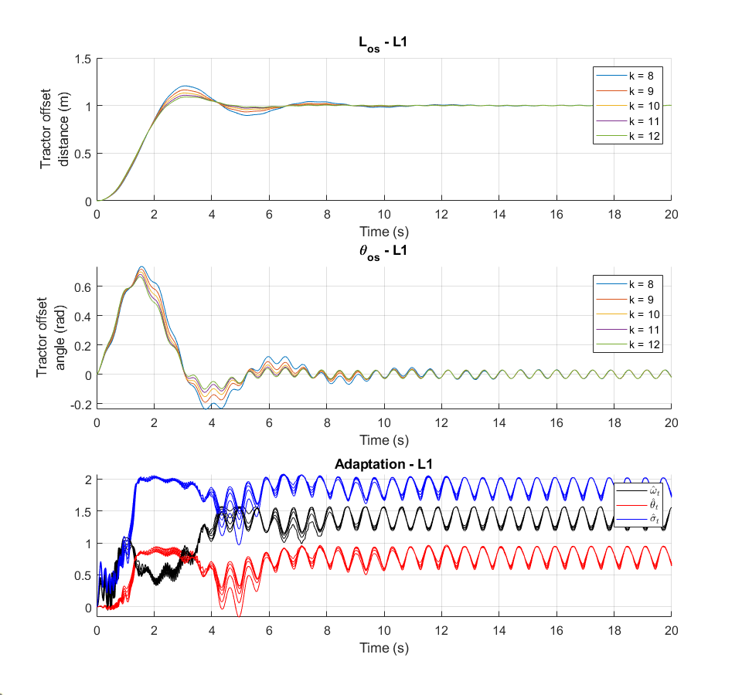
Adjusting bandwidth $k$ subject, system subject to mid-frequency input disturbance $u\left(t\right)=u_{ad}\left(t\right)+k_{x}^{T}x+sin\left(10t\right), δ=\tan^{−1}\left(u\left(t\right)\right)$
Minimal improvement in tracking beyond $k=10$ to disturbance $\sin\left(10t\right)$
ME562
GRAINGER ENGINEERING
Notes:
[Sam] In this slide, we are looking at how adjusting the bandwidth affects the tracking and the adaptation. For a sinusoidal disturbance, the most that the controller can do is reject the component of the disturbance which would propagate though the system. There will still be fluctuations since the disturbance is bypassing the filter and the controller. We see here the same trend as before that increasing bandwidth increases performance, but it does not do too much to the fluctuations caused by the disturbance.

Slide 17
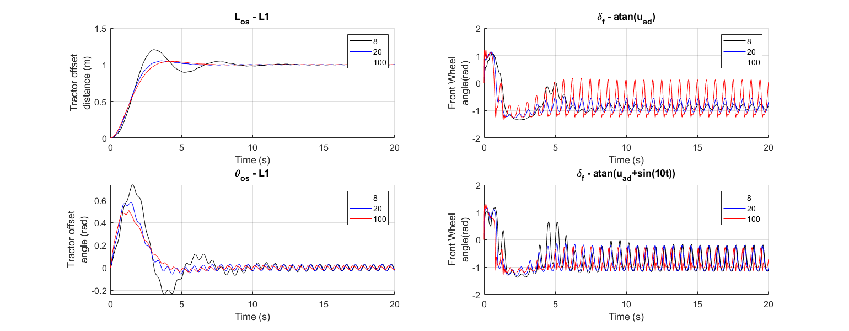
Effects of input disturbance $\sin\left(10t\right)$and bandwidth on control signal $u_{ad}\left(t\right)$ and $u(t)$
Control Signal
Control Signal with disturbance
For all bandwidths, control signal $u(t)$ similar although amplitude of $u_{ad}\left(t\right)$ differ
ME562
GRAINGER ENGINEERING
Notes:
[Sam] This slide is included to see the difference between the adaptive control signal from the controller and the control signal entering the system with noise. We see that the control signal entering the plant reaches a constant amplitude for all bandwidths, even though the adaptive control signal has bandwidth-dependent amplitude, with higher bandwidth corresponding with higher amplitude.

Slide 18
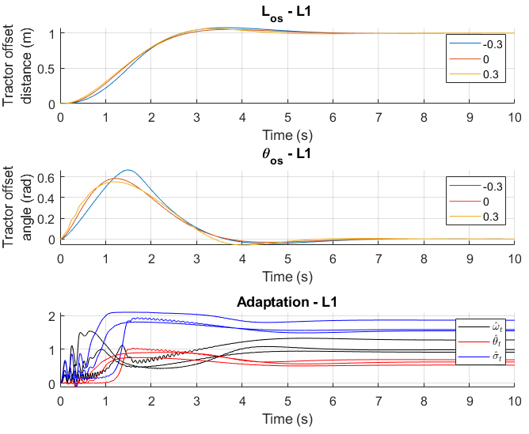
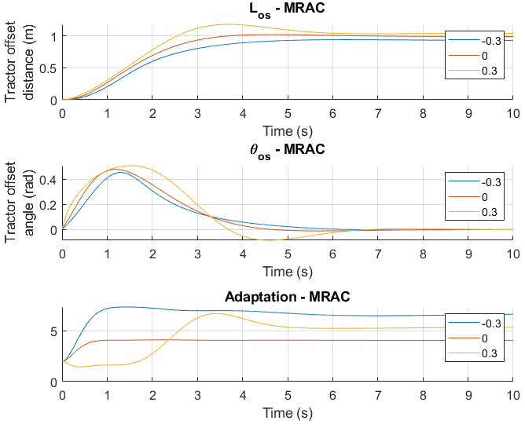
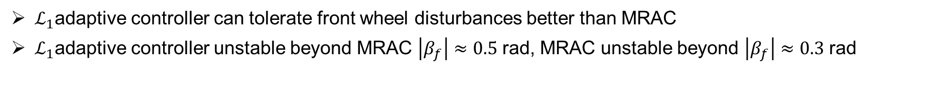
Comparing response of MRAC and $ℒ_{1}$-adaptive controller to state disturbances $Δ$
$$β_{f}∈\left[−0.3, 0, 0.3\right]$$
$ℒ_{1}$adaptive controller can tolerate front wheel disturbances better than MRAC
$ℒ_{1}$adaptive controller unstable beyond MRAC $\left|β_{f}\right|≈0.5$ rad, MRAC unstable beyond $\left|β_{f}\right|≈0.3$ rad
ME562
GRAINGER ENGINEERING
Notes:
[Sam] Our tractor-trailer model has certain disturbances incorporated into the dynamic equations, including three velocity disturbances and 1 angular disturbance. The most noticeable of these is the angular disturbance. This angular disturbance, beta-f, is a measure of the slip direction of the front wheel, causes the system to go unstable at large values. As we see here, the L1-adaptive control does a more consistent job compensating for constant disturbances. Additionally, the L1 adaptive control is stable for higher values of beta-f.

Slide 19
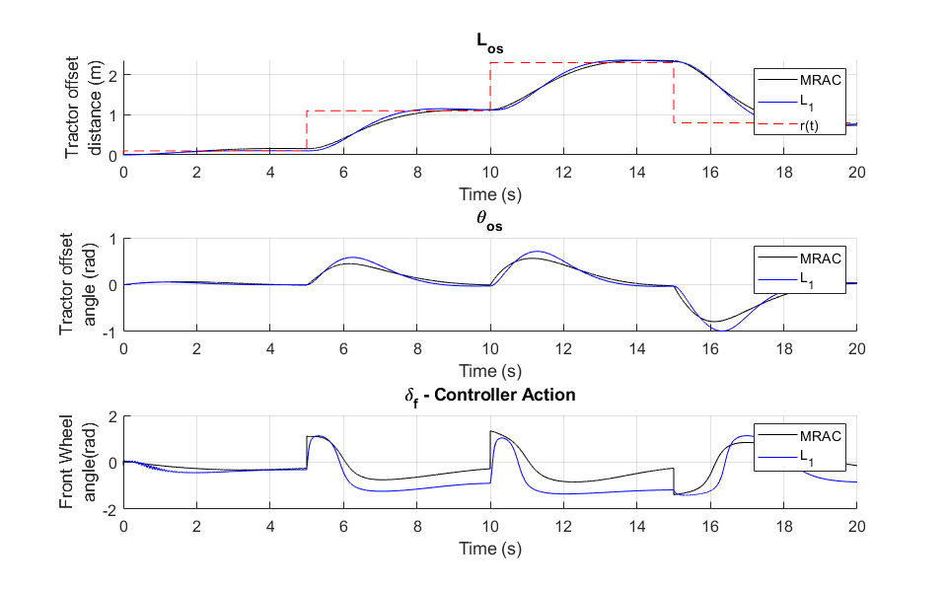
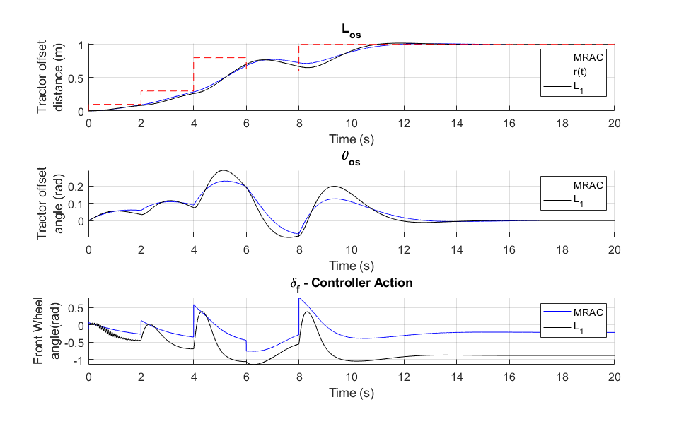


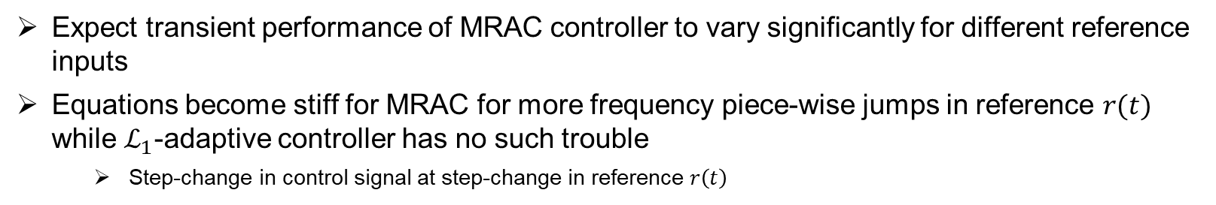
Minimal difference in tracking a changing reference $r\left(t\right)$ for constant $Γ$ between MRAC controller and $ℒ_{1}$-adaptive controller
$$r_{1}\left(t\right)$$
$$r_{2}\left(t\right)$$
Expect transient performance of MRAC controller to vary significantly for different reference inputs
Equations become stiff for MRAC for more frequency piece-wise jumps in reference $r(t)$ while $ℒ_{1}$-adaptive controller has no such trouble
Step-change in control signal at step-change in reference $r\left(t\right)$
ME562
GRAINGER ENGINEERING
Notes:
[Sam] We also wanted to see how constant gamma affected tracking a changing reference, comparing MRAC and L1. We had similar performance in both cases, with the one major difference being the sharp control signal change in the MRAC controller. This control signal would not be implementable, so for these step-changes in the reference, we would expect controller saturation resulting in oscillations and a loss of performance. The L1 controller does a decent job limiting the slope of the control signal. By adjusting the filter, we could attempt to limit the control signal to rates of change realizable by the actuator. MRAC does not have this type of flexibility.

Slide 20
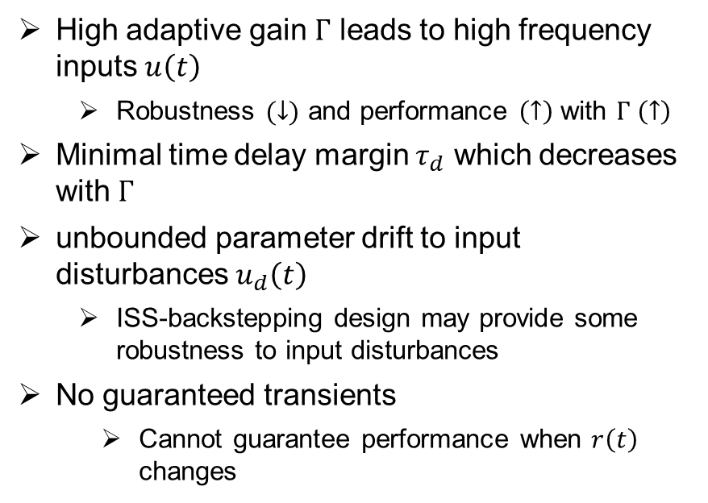

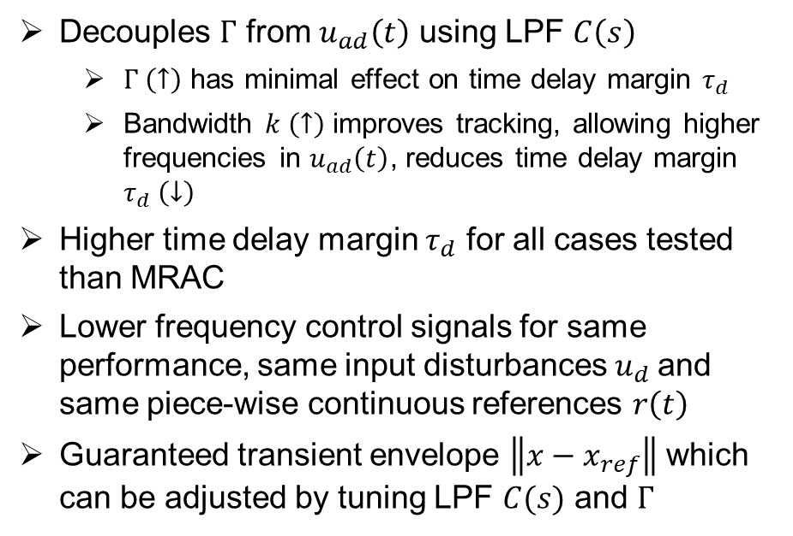
Summary of observations and Conclusions
$ℒ_{1}$-adaptive control
MRAC
Decouples $Γ$ from $u_{ad}\left(t\right)$ using LPF $C\left(s\right)$
$Γ \left(↑\right)$ has minimal effect on time delay margin $τ_{d}$
Bandwidth $k \left(↑\right)$ improves tracking, allowing higher frequencies in $u_{ad}\left(t\right)$, reduces time delay margin $τ_{d} \left(↓\right)$
Higher time delay margin $τ_{d}$ for all cases tested than MRAC
Lower frequency control signals for same performance, same input disturbances $u_{d}$and same piece-wise continuous references $r\left(t\right)$
Guaranteed transient envelope $\left\|x−x_{ref}\right\|$ which can be adjusted by tuning LPF $C(s)$ and $Γ$
High adaptive gain $Γ$ leads to high frequency inputs $u\left(t\right)$
Robustness $(↓)$ and performance $\left(↑\right)$ with $Γ \left(↑\right)$
Minimal time delay margin $τ_{d}$ which decreases with $Γ$
unbounded parameter drift to input disturbances $u_{d}\left(t\right)$
ISS-backstepping design may provide some robustness to input disturbances
No guaranteed transients
Cannot guarantee performance when $r\left(t\right)$ changes
$ℒ_{1}$ adaptive control would help where transients risk destroying crops at corners of fields
Possesses sufficient robustness to surface property and topological disturbances
GRAINGER ENGINEERING
Notes:
[Sam] In conclusion,
We see how L1 –adaptive control decouples the adaptive gain from the control signal using a low pass filter. We see how the design of this low pass filter can allow us to trade between performance and robustness to time delay and input disturbance.
We also see that L1-adaptive control generally has a lot more time delay margin than MRAC, and generally does a better job at providing smoother, implementable control signals thanks to the Low pass filtering.
Lastly, The L1 adaptive controller can provide guaranteed transient performance which is not achieved with MRAC. This could be useful for our tractor-trailer system in particular because path planning requires not running over crops during transients. Additionally, we have reason to believe it would perform as well as the MRAC scheme thanks to its robustness to friction coefficient and topological disturbances.

Slide 21
References
[1] Huynh, V.T., (2011), Model Development and Control for an Agricultural Tractor-trailer under the Influence of Slip. Masters Thesis, School of Mechanical and Manufacturing Engineering, The University of New South Wales.
[2] Morgan, Robert (2015) "Linearization and Stability Analysis of Nonlinear Problems," Rose-Hulman Undergraduate Mathematics Journal: Vol. 16 : Iss. 2 , Article 5. Available at: https://scholar.rose-hulman.edu/rhumj/vol16/iss2/5
[3] Hovakimyan, N., & Cao, C. (2010). L1 adaptive control theory : guaranteed robustness with fast adaptation . Society for Industrial and Applied Mathematics SIAM, 3600 Market Street, Floor 6, Philadelphia, PA 19104.
GRAINGER ENGINEERING
Notes:
[Sam]

